Slide 1
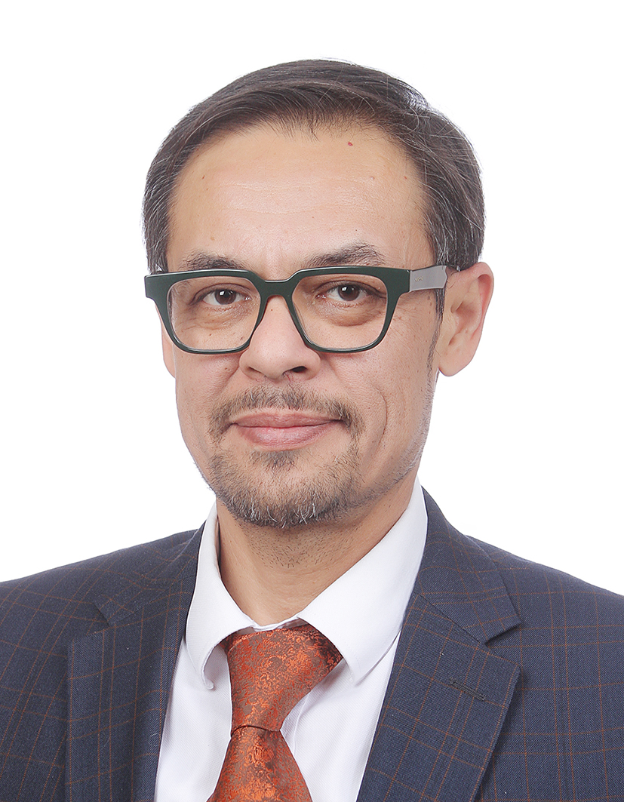
Safeguarding Digital Assets: Cybersecurity Imperatives for Uzbekistan's Crypto Exchange Ecosystem
GULYAMOV SAID SAIDAKHRAROVICH
Professor, DSc (Law)
Head of the Department of Cyber Law
Tashkent State University of Law (Uzbekistan)

Slide 2

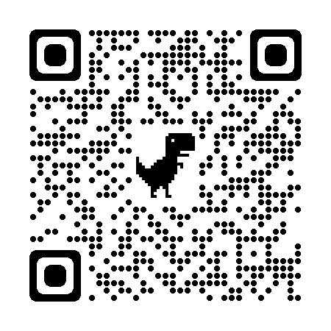

Introduction
The rapid growth of the digital asset market has brought cybersecurity to the forefront of industry challenges.
Crypto exchanges store vast amounts of digital assets and sensitive user information, making them the primary target for cyberattacks.
The consequences of cybersecurity breaches can be severe, leading to the loss of digital assets worth millions of dollars, compromising users' personal information, and undermining trust in the market.
WWW.GULYAMOV.ORG

Slide 3

Current and Expected Cybersecurity Threats Faced by Crypto Exchanges
Hacking attempts, phishing attacks, and insider threats pose significant risks for digital asset exchanges.
Technological vulnerabilities arising from infrastructure complexity and the rapidly evolving digital asset landscape create additional challenges.
The cybersecurity situation for cryptocurrency exchanges is likely to become even more complex in the future due to the growing value of digital assets, sophistication of cybercriminals, and the emergence of quantum computing.
WWW.GULYAMOV.ORG

Slide 4

Effectiveness of Various Mitigation Measures
Implementing multi-factor authentication (MFA) significantly reduces the risk of unauthorized access to user accounts.
Using hardware security modules (HSMs) for storing and managing private keys minimizes the risk of key theft and unauthorized transactions.
Real-time monitoring systems, regular security audits, and training for employees and users also play a crucial role in mitigating cyber threats.
WWW.GULYAMOV.ORG

Slide 5

Importance of Developing and Implementing a Comprehensive Cybersecurity Policy
Comprehensive cybersecurity policies ensure a consistent and effective approach to managing cybersecurity risks.
Key components include a risk management framework, incident response, business continuity planning, and regulatory compliance.
Regular review and updating of policies are necessary to ensure their effectiveness and relevance in the face of evolving threats and changing business requirements.
WWW.GULYAMOV.ORG

Slide 6

Legal and Technological Tools Available to Crypto Exchanges for Enhancing Cybersecurity
Blockchain-based identity verification and zero-knowledge proofs (ZKP) can help enhance user privacy and security.
Secure multi-party computation (MPC) allows processing transactions and performing key management operations without disclosing sensitive data.
Contractual agreements, terms of service, and cybersecurity insurance can mitigate legal and financial risks associated with cybersecurity incidents.
WWW.GULYAMOV.ORG

Slide 7

Current State of Cybersecurity Regulations for Crypto Exchanges in the Republic of Uzbekistan and Potential Future Changes
Uzbekistan has taken steps to establish a regulatory framework for the digital asset industry.
However, the regulatory landscape is still evolving, and there are vectors for development in this direction.
Potential future changes may include establishment, fostering cooperation (including in the field of cybersecurity), and developing more specialized rules.
WWW.GULYAMOV.ORG

Slide 8

Comparison of the Cybersecurity Situation of Crypto Exchanges in the Republic of Uzbekistan with the Situation in Other Countries
Uzbekistan has recognized the need for a regulatory framework to address cybersecurity concerns.
Despite differences in regulatory landscapes, the cybersecurity challenges faced by crypto exchanges are largely similar across countries.
WWW.GULYAMOV.ORG

Slide 9
Conclusion
Robust cybersecurity measures and policies are crucial for protecting crypto exchange infrastructure and user assets from the growing range of cyber threats.
Collaborative efforts among stakeholders to address cybersecurity challenges will contribute to the development of a more secure and reliable digital asset ecosystem in Uzbekistan and worldwide.
WWW.GULYAMOV.ORG

Slide 10
Proposals based on the outcomes of the "Financial Institutions" Section
№ | Problem Statement | Recommendations and Proposals | Target Audience | Expected Results
1 | Growing cyber threats to cryptocurrency exchanges, including hacking attempts, phishing attacks, and insider threats | Implement multi-factor authentication, real-time monitoring systems, and regular security audits | Cryptocurrency exchanges | Enhanced protection against unauthorized access, timely detection of incidents, and proactive identification of vulnerabilities
2 | Need for a comprehensive cybersecurity policy to manage risks and respond to incidents | Develop policies with clear objectives, roles, incident response procedures, and business continuity planning | Cryptocurrency exchanges | Consistent and effective approach to managing cybersecurity risks across the organization
3 | Demand for innovative technological solutions to enhance privacy and security | Explore the potential of blockchain-based identity verification, zero-knowledge proofs, and secure multi-party computation | Cryptocurrency exchanges, researchers | Improved protection of user data, secure authentication processes, and reduced risks of sensitive information leakage
4 | Evolving regulatory landscape for digital assets in Uzbekistan with opportunities for improvement | Develop specialized regulatory requirements, foster industry collaboration, and create regulatory "sandboxes" for testing new approaches | Regulatory authorities, cryptocurrency exchanges | Tailored regulations that promote innovation, consumer protection, and market integrity
5 | Importance of collaboration and information sharing among stakeholders to combat cyber threats | Establish channels for sharing threat intelligence and best practices among exchanges, regulators, and law enforcement agencies | Cryptocurrency exchanges, regulators, law enforcement agencies | Coordinated industry approach to cybersecurity, enabling rapid response to incidents and emerging threats

Slide 11

THANK YOU FOR THE ATTENTION !
WWW.GULYAMOV.ORG

