Slide 1

CYBERNEUROSECURITY
IN THE DIGITAL AGE
GULYAMOV SAID SAIDAKHRAROVICH
Doctor of Law Science, Professor,
Head of the Department of Cyber Law
of the Tashkent State University of Law

Slide 2


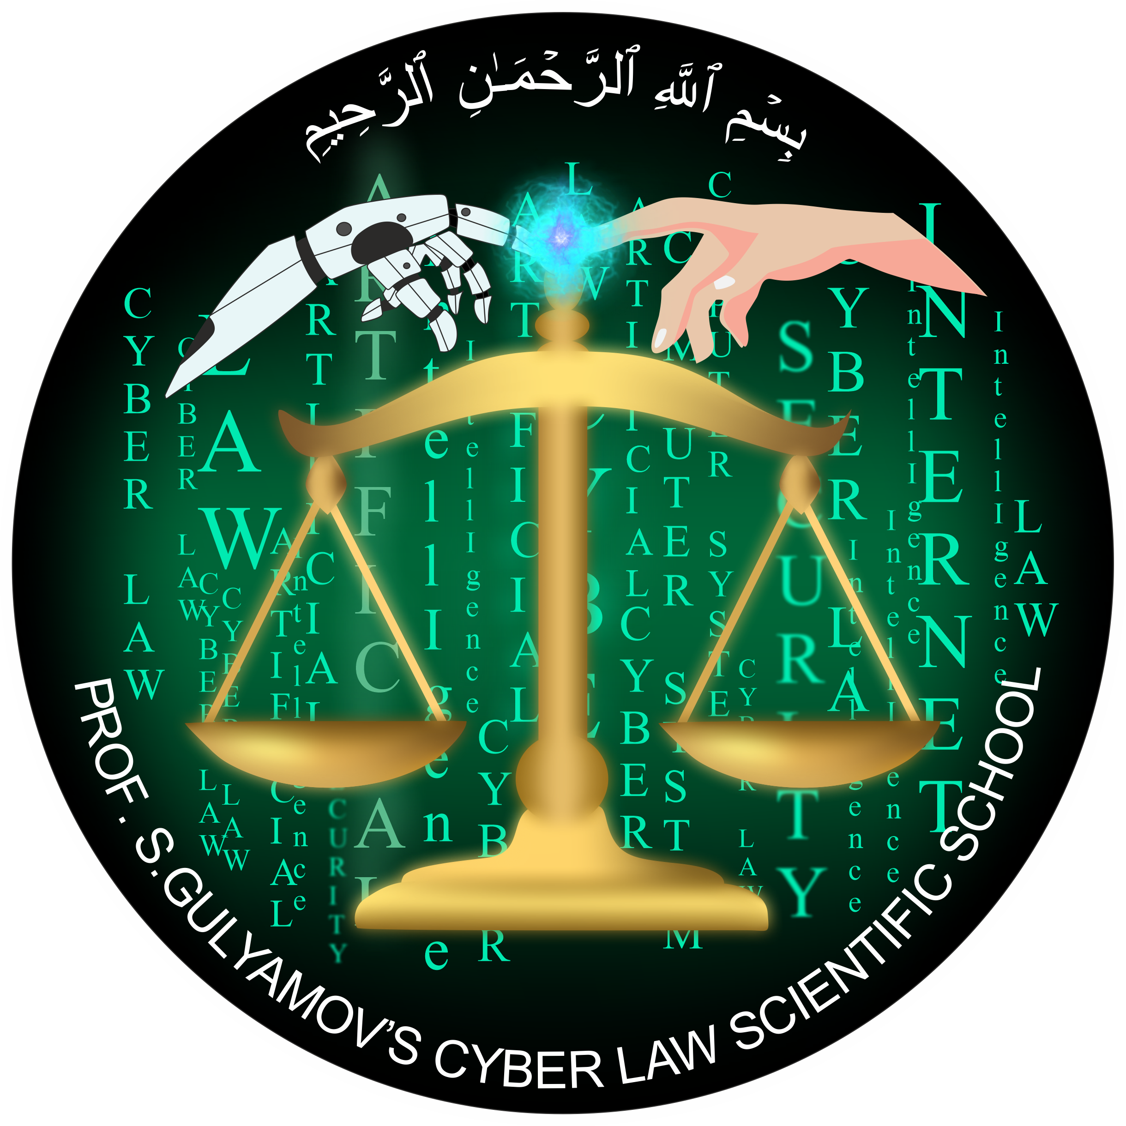
Introduction
Cyberneurosecurity is an emerging field of cybersecurity focused on the unique challenges and threats associated with the use of neurotechnologies
The need to develop comprehensive technical, ethical, and governance frameworks to ensure the responsible development and deployment of these technologies
Analysis of existing threats and vulnerabilities, as well as emerging solutions and best practices across various domains
WWW.GULYAMOV.ORG

Slide 3

Defining Cybersecurity and Cyberneurosecurity
Cybersecurity is the protection of computer systems, networks, and data from unauthorized access, use, disclosure, disruption, modification, or destruction
Cyberneurosecurity is the protection of neural data and the integrity of neurotechnologies, as well as addressing the specific issues arising from the direct interaction between neurotechnologies and the human brain
The consequences of cyberneurosecurity breaches can be severe, as they can impact an individual's privacy, autonomy, and even personal identity
WWW.GULYAMOV.ORG

Slide 4

Key Differences Between Cybersecurity and Cyberneurosecurity
Object of protection: cybersecurity protects digital systems and data, cyberneurosecurity protects neural data and the integrity of neurotechnologies
Key aspects: cyberneurosecurity involves not only technical measures but also ethical, social, and legal considerations
Key threats: cyberneurosecurity faces threats of unauthorized access, use, or manipulation of neural data, hacking of neurotechnologies, and the potential for cognitive manipulation or enhancement
WWW.GULYAMOV.ORG

Slide 5
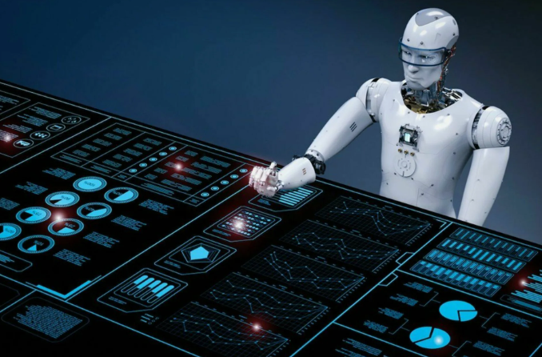
Neuromorphic Computers: Concept, Specifics, and Distinguishing Features
Neuromorphic computers mimic the architecture and functions of biological neural networks
They integrate memory and processing into a single massively parallel network of artificial neurons and synapses
Neuromorphic computers can learn and adapt through experience, are fault-tolerant and robust to noise
WWW.GULYAMOV.ORG

Slide 6
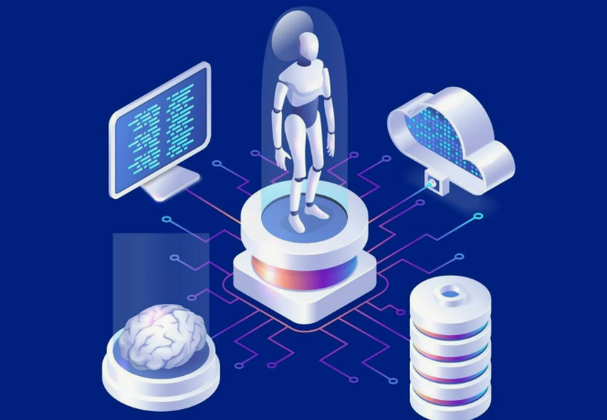
Key Differences Between Cyberneurosecurity and Cyberneuromorphic Security
Cyberneurosecurity deals with the interface between the biological and digital realms, focusing on issues arising from direct interaction with human neural systems
Cyberneuromorphic security deals with purely artificial systems that mimic brain-like computations
Cyberneurosecurity must contend with the inherent variability and complexity of biological systems, cyberneuromorphic security focuses on threats more akin to traditional cybersecurity issues
WWW.GULYAMOV.ORG

Slide 7

The Unique Role of AI in Cyberneurosecurity
The direct interaction of neurotechnologies with the human brain creates unique vulnerabilities and risks
The unique nature of each person's brain anatomy and functioning requires a highly personalized approach to ensuring the security and privacy of neural data and systems
Developing secure and reliable AI-based neurotechnologies involves integrating complex hardware and software components, as well as a deep understanding of both the biological and technological aspects
WWW.GULYAMOV.ORG

Slide 8
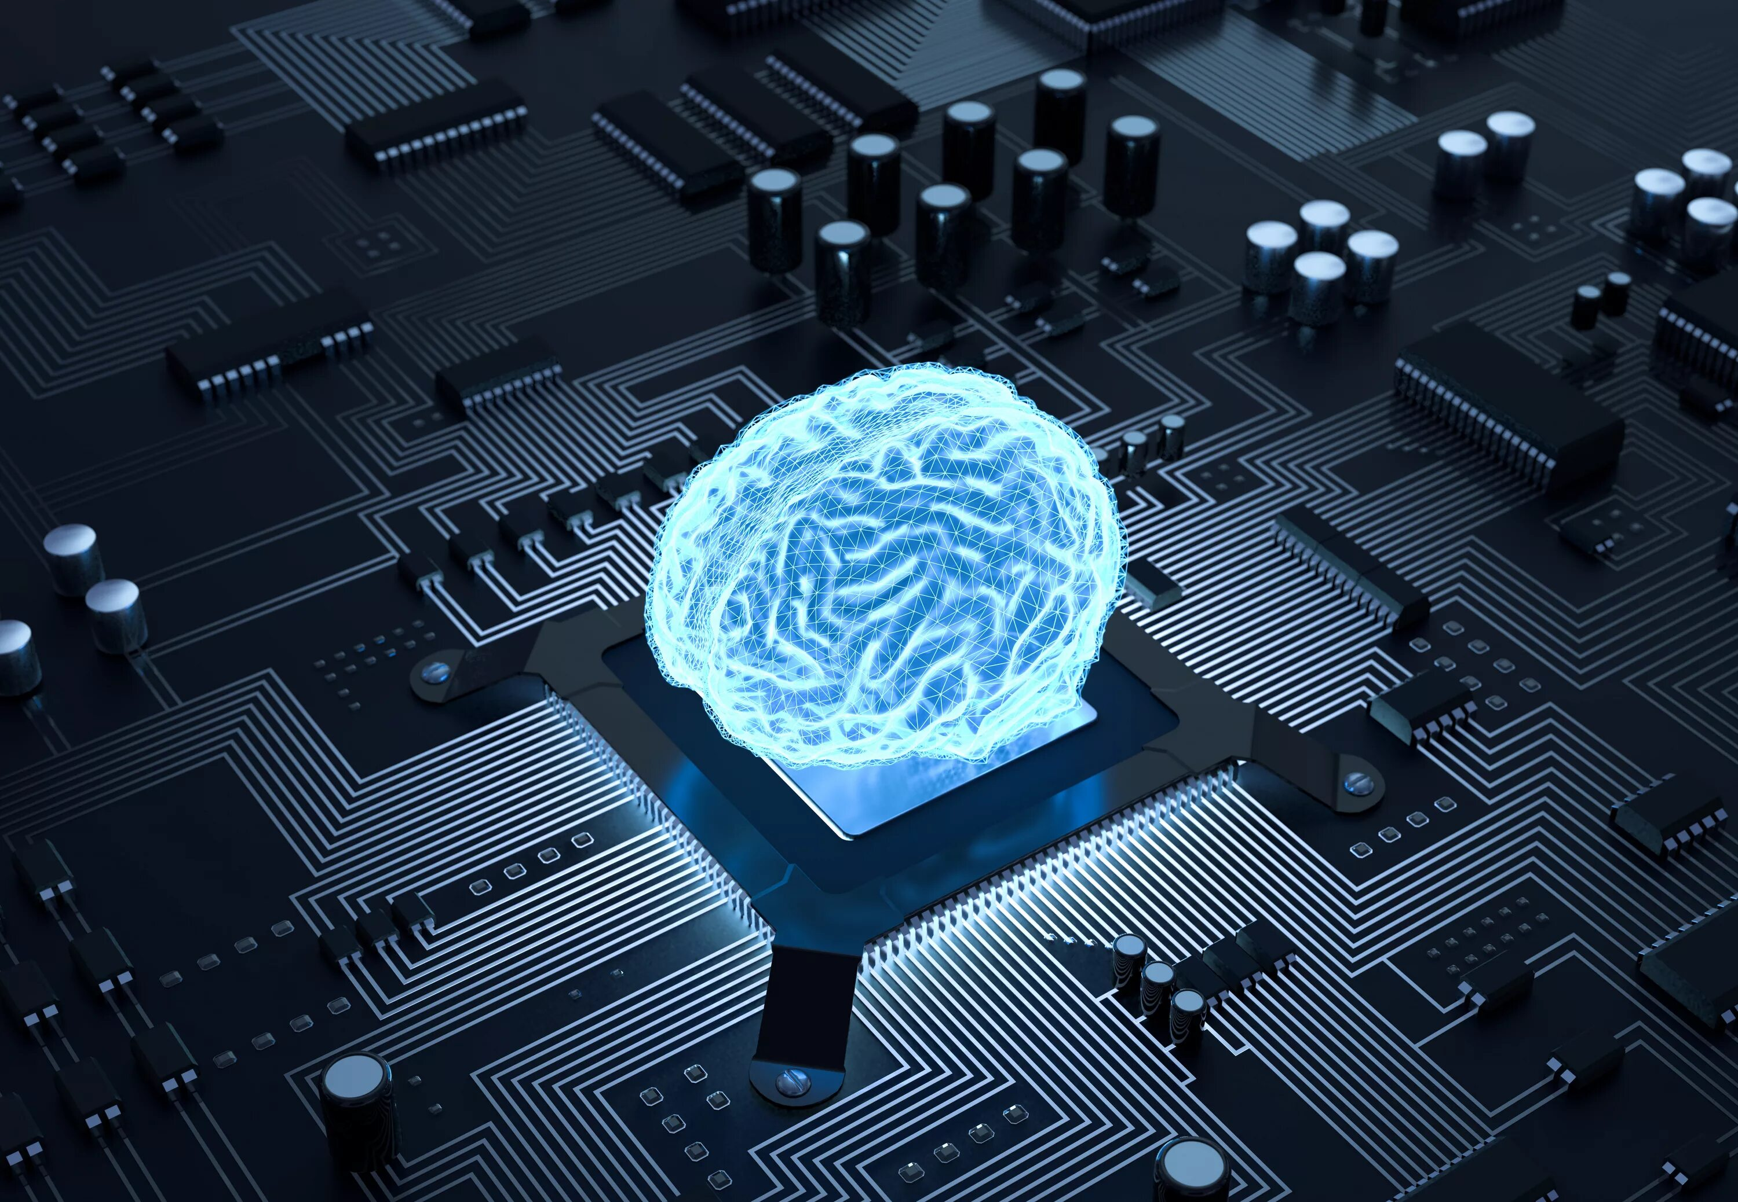
The Role of Advanced Digital Technologies in Ensuring Cyberneurosecurity: Internet of Things, Blockchain, Digital Twins, and Interactive Systems
The Internet of Things enables the collection and transmission of neural data, enabling remote monitoring and control of neurotechnology devices, but also introduces new attack vectors and security vulnerabilities
Blockchain can be used to create a secure and transparent infrastructure for storing, sharing, and analyzing neural data, ensuring its integrity, accountability, and protection from unauthorized access or tampering
Digital twins can provide valuable insights for the development and testing of neurotechnology devices or interventions, but also introduce new privacy and cybersecurity risks that need to be carefully considered
WWW.GULYAMOV.ORG

Slide 9
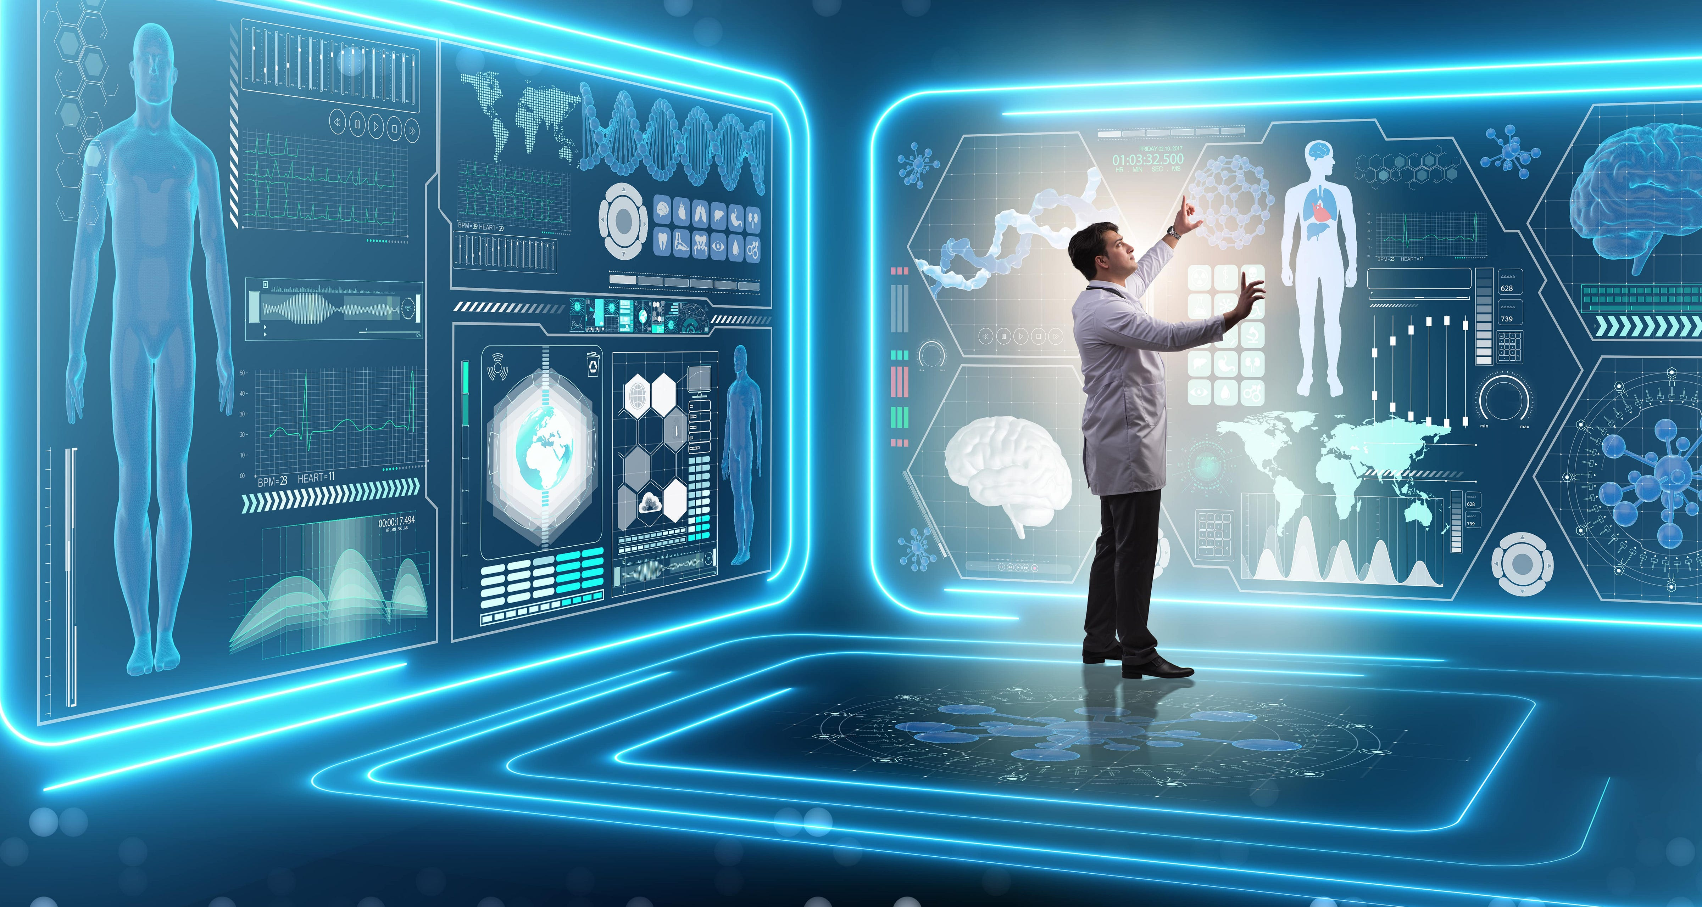
Digital Twins and their Significance for Cyberneurosecurity in the Context of Interactive Neurotechnologies
Digital twins can be integrated with interactive neurotechnologies, such as virtual reality, augmented reality, and brain-computer interfaces, to enable personalized, adaptive, and context-aware interactions
The use of digital twins in neurotechnologies introduces new privacy and cybersecurity risks that need to be carefully considered
Robust cybersecurity and data governance mechanisms need to be implemented throughout the entire lifecycle of digital twins to ensure the integrity and confidentiality of digital twin data
WWW.GULYAMOV.ORG

Slide 10
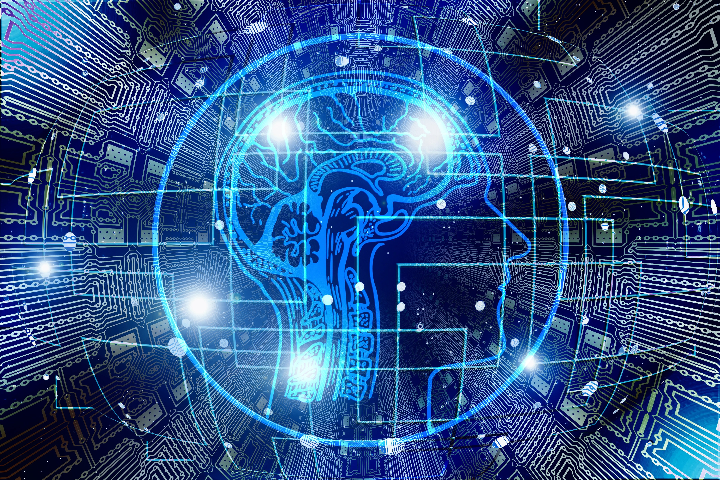
Overview of Regulatory Activities in Cyberneurosecurity
The need to establish robust regulatory and legal frameworks to ensure the responsible development and use of neurotechnologies
Analysis of international guidelines, regional and national legislation, industry standards, research initiatives, and ethical frameworks that shape the governance of neurotechnologies
Existing efforts and identifying potential gaps and challenges to balance the benefits and risks of neurotechnologies while protecting individual rights and societal values
WWW.GULYAMOV.ORG

Slide 11
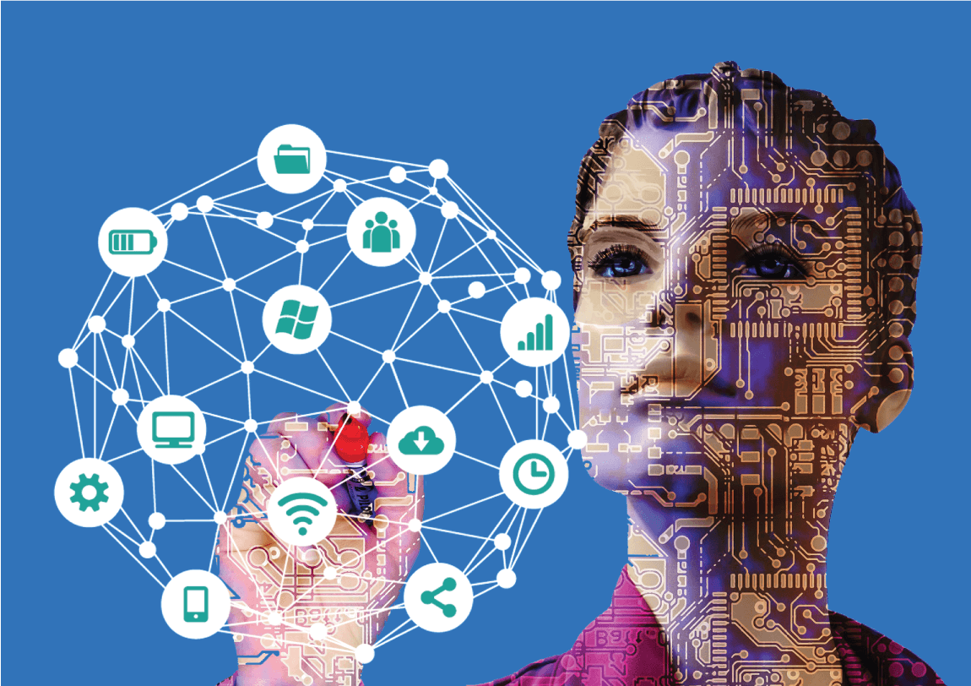
International Guidelines and Initiatives
OECD Recommendation on Responsible Innovation in Neurotechnology, the first international standard in this area
European Parliament Resolution of 16 February 2017 with recommendations to the Commission on Civil Law Rules on Robotics (including neurotechnologies)
UNESCO document "Neurotechnology and Human Rights: Risks and Challenges," analyzing the potential risks and issues neurotechnologies may pose for human rights
WWW.GULYAMOV.ORG

Slide 12
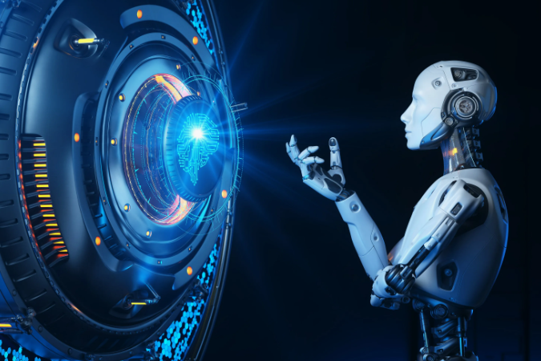
European Union Legislation
The General Data Protection Regulation (GDPR) sets stringent requirements for the protection of personal data, including health data and biometric data obtained through biotechnologies and neurotechnologies
The EU Cybersecurity Act establishes a framework for the cybersecurity certification of ICT products, processes, and services, including those related to emerging technologies such as the Internet of Things and artificial intelligence
WWW.GULYAMOV.ORG

Slide 13
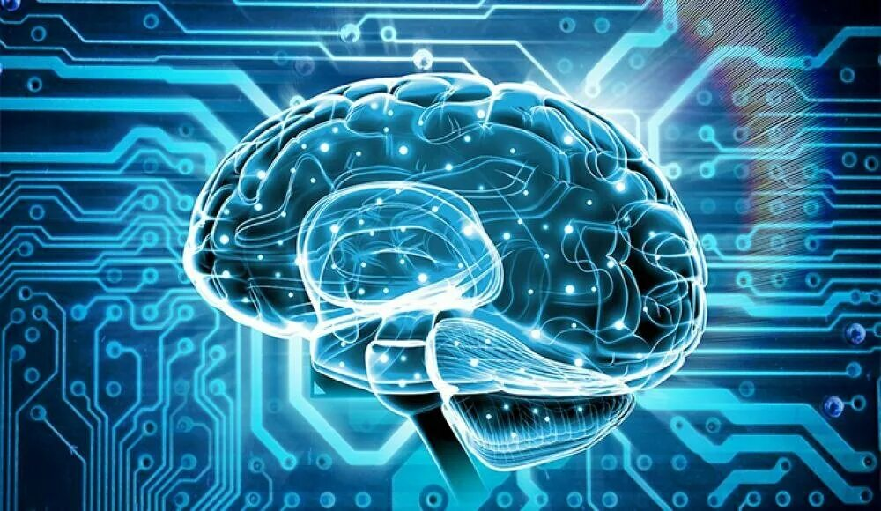
United States Legislation
The Health Insurance Portability and Accountability Act (HIPAA) establishes national standards for protecting the confidentiality of patients' health information, which may include data collected through neurotechnology devices and applications
The U.S. Internet of Things (IoT) Cybersecurity Improvement Act of 2020 establishes minimum security standards for IoT devices owned or controlled by the federal government, which may have implications for neurotechnology devices connected to the Internet or other networks
WWW.GULYAMOV.ORG

Slide 14
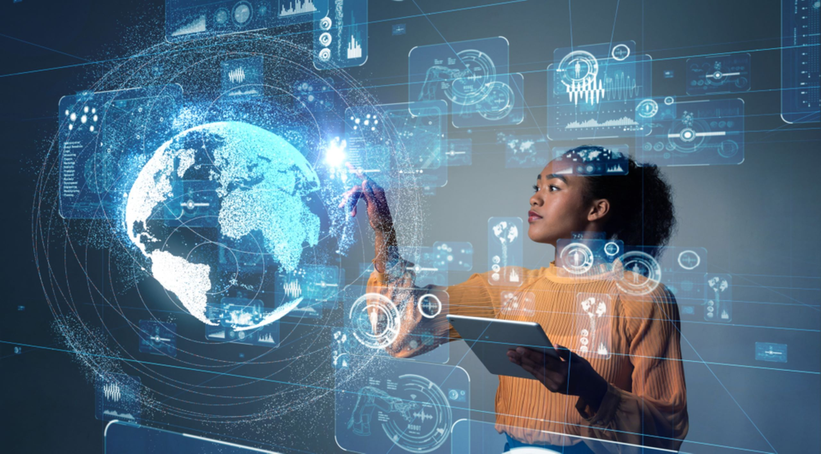
Legislation from Other Countries
China's Cybersecurity Law establishes security requirements for network operators and providers of network products and services
Singapore's Cybersecurity Act 2018 establishes a legal framework for the oversight and maintenance of national cybersecurity, including the protection of critical information infrastructure
WWW.GULYAMOV.ORG

Slide 15
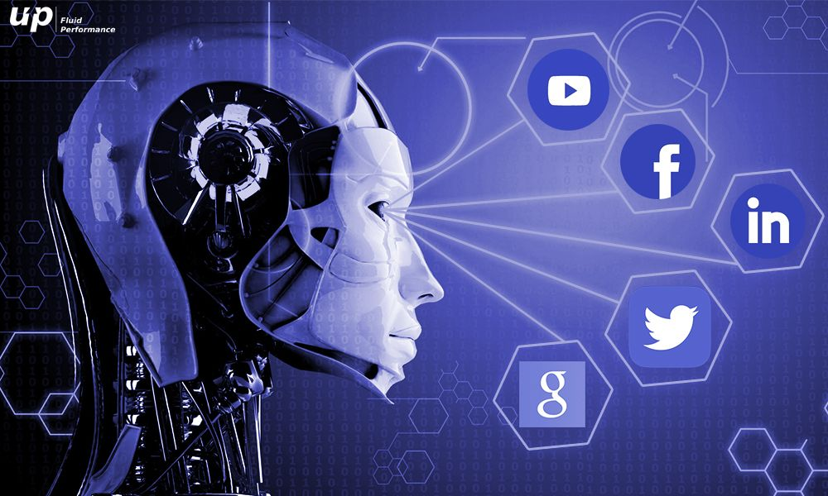
Industry Standards and Guidelines
ISO/IEC 27001 - Information Security Management System Standard
NIST SP 800-53 - Security and Privacy Controls for Information Systems and Organizations
IEEE 7010-2020 - Standard for Assessing the Impact of Autonomous and Intelligent Systems on Human Well-being
IEEE Standards Projects (IEEE P2725.1, IEEE P2794, IEEE P2731) - Neurotechnologies and Brain-Computer Interfaces
WWW.GULYAMOV.ORG

Slide 16

Organizations and Committees
European Medicines Agency (EMA) - Regulation of Neurotechnologies as Medical Devices
Japan Brain/MINDS - Neuroethics Subcommittee
ISO/IEC JTC 1/SC 42 - Artificial Intelligence
IEEE Brain Technical Community
WWW.GULYAMOV.ORG

Slide 17

Projects and Programs
DARPA Research Programs (U.S.)
National Science and Technology Council Committee on Science, Neuroscience Interagency Working Group (U.S.)
Canadian Brain Research Strategy (CBRS)
U.S. BRAIN Initiative
International Brain Initiative (IBI)
Brain/MINDS Beyond (Japan)
WWW.GULYAMOV.ORG

Slide 18
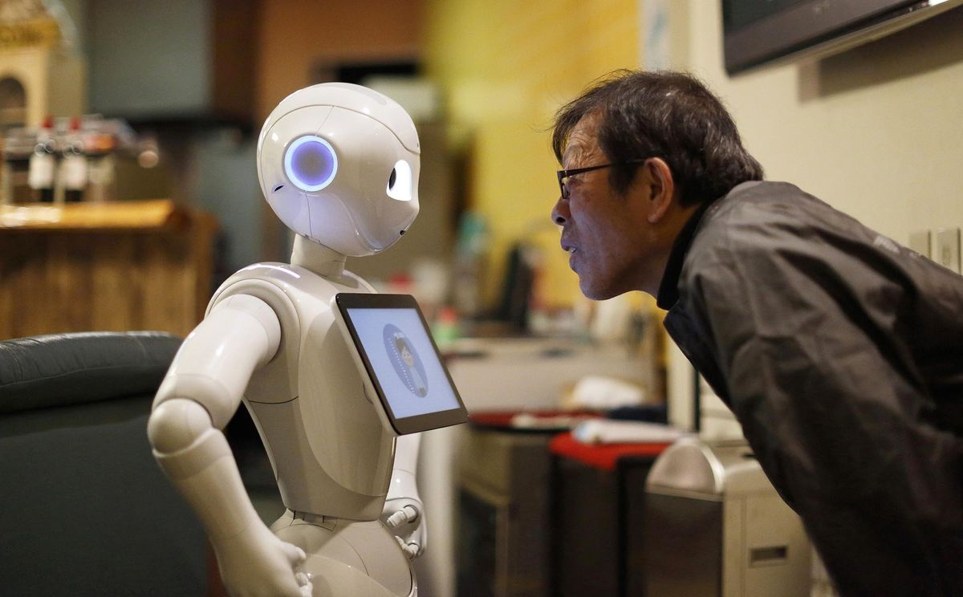
Codes and Initiatives
Morningside Neurotechnologies Ethical Code
IEEE Brain Initiative - Neuroethical Framework
NIH BRAIN Initiative - Neuroethics Guiding Principles (U.S.)
WWW.GULYAMOV.ORG

Slide 19
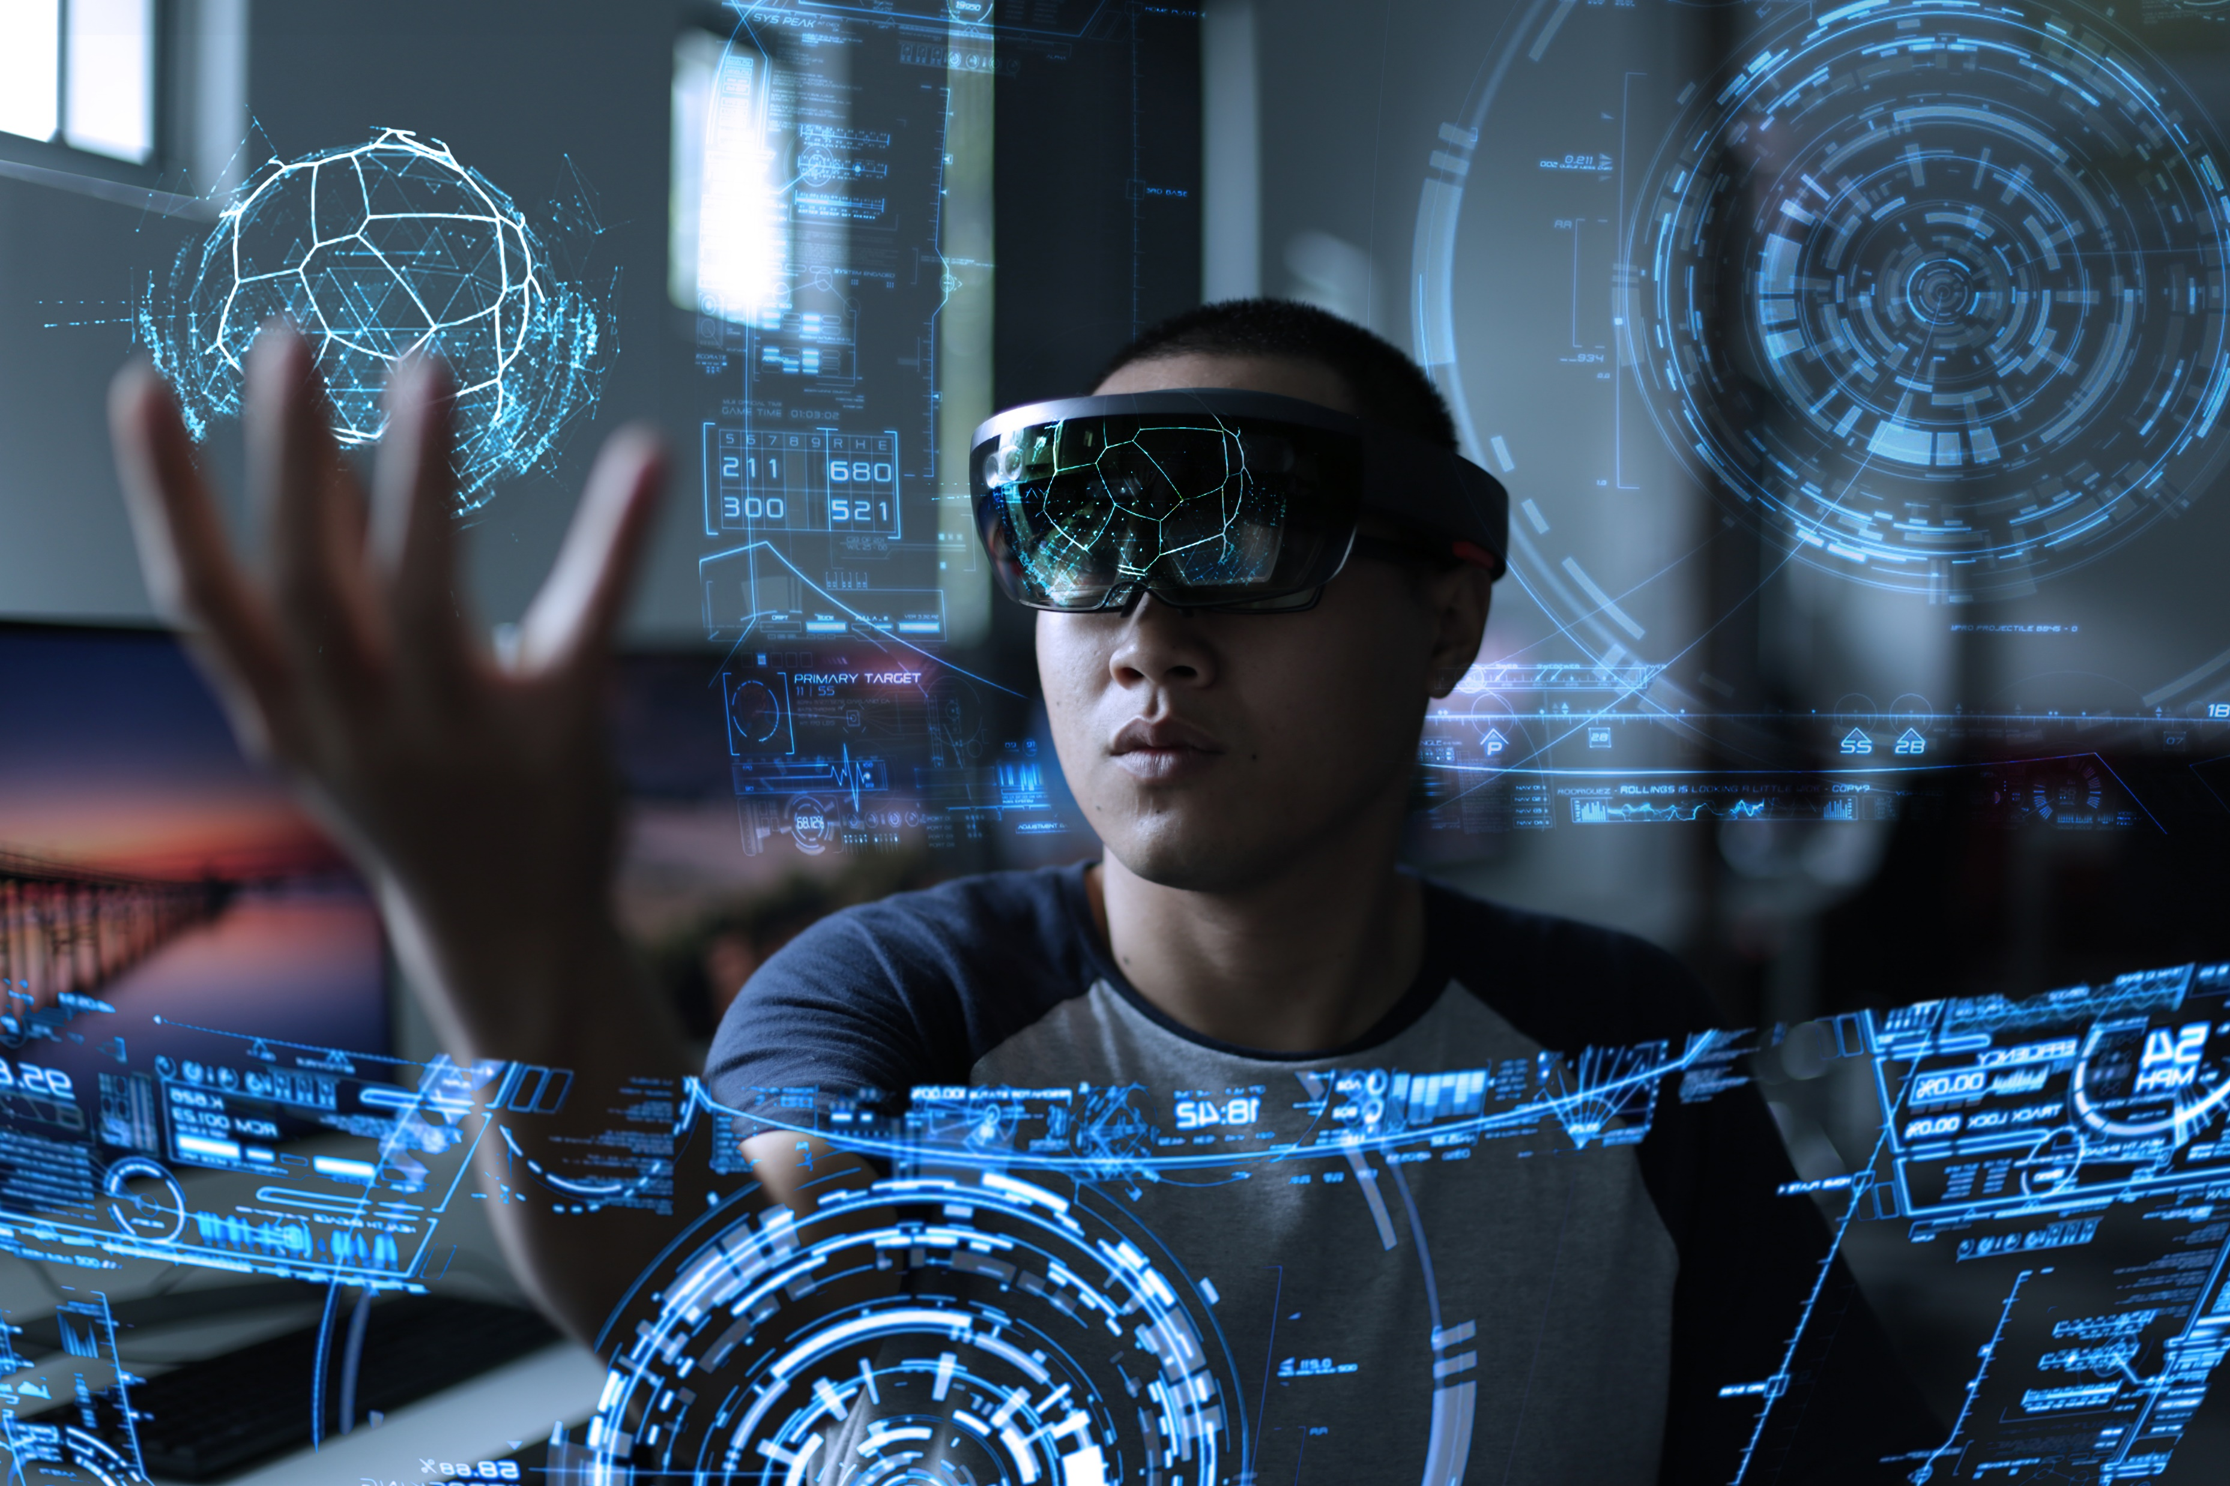
Other Documents
The Royal Society (UK) - iHuman Perspective: Neural Interfaces
WWW.GULYAMOV.ORG

Slide 20
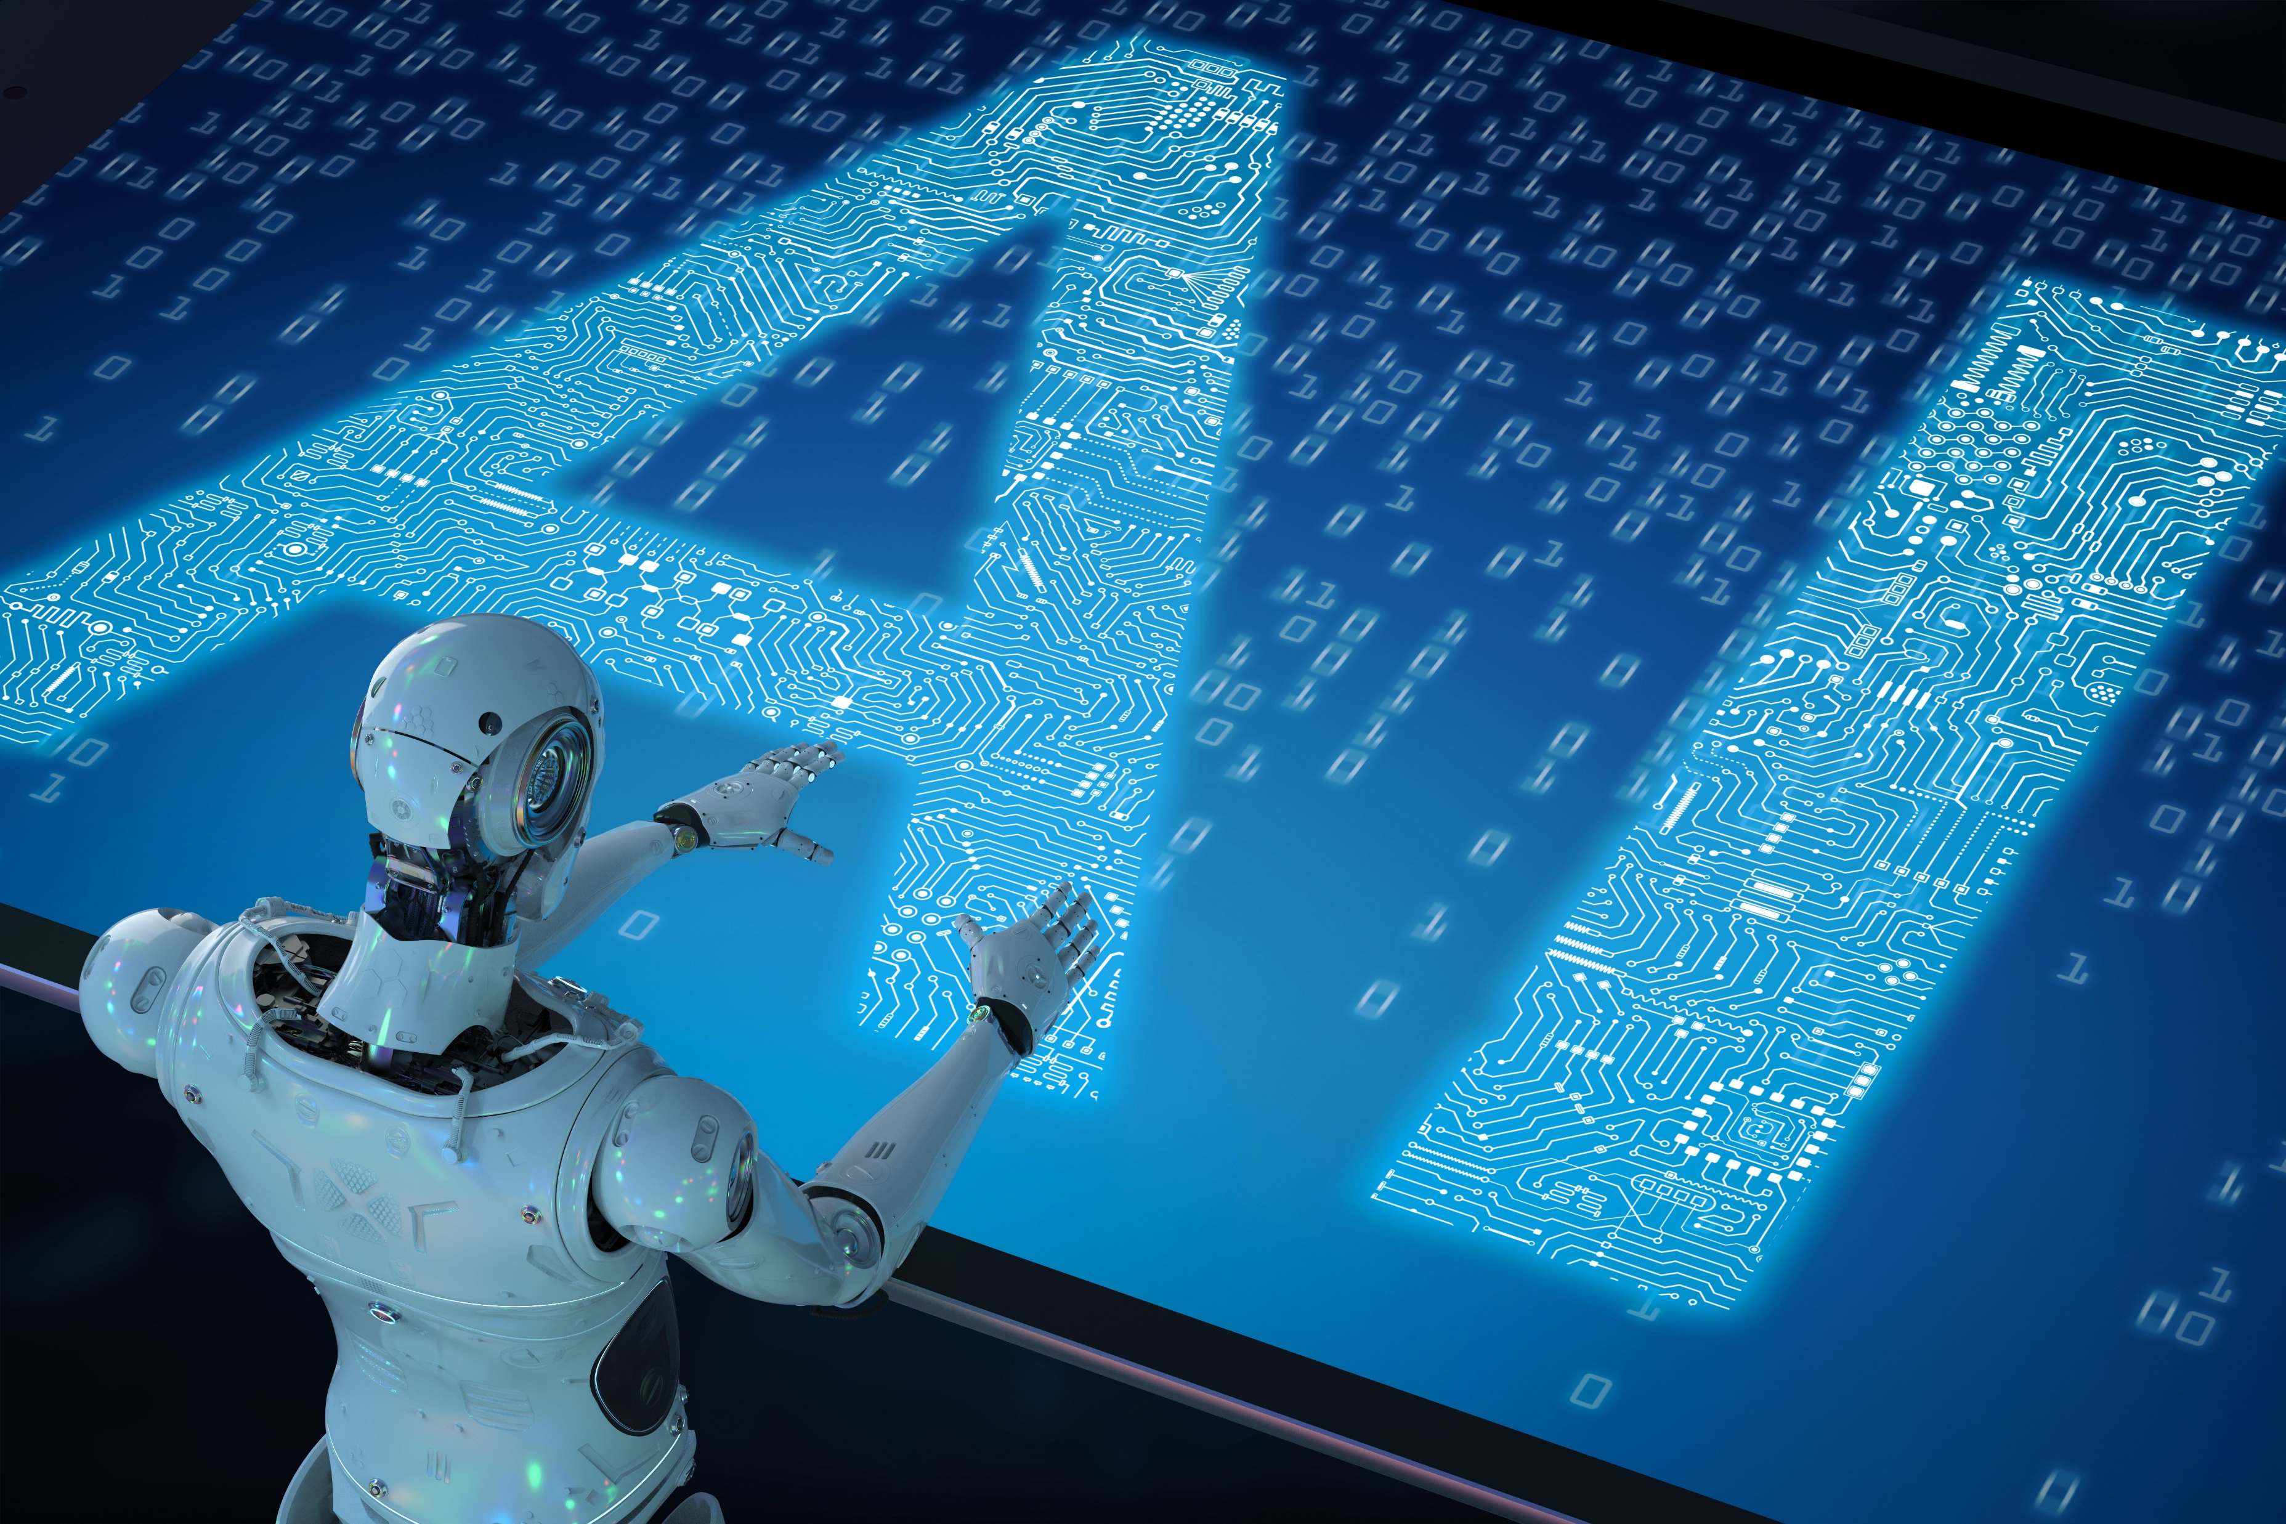
National Laws and Policies on Neurotechnologies
Santiago Neurorights Law (Chile)
The Chilean Senate unanimously approved a bill to amend the constitution to protect neurorights
WWW.GULYAMOV.ORG

Slide 21

THANK YOU FOR THE ATTENTION!
WWW.GULYAMOV.ORG

