Slide 1

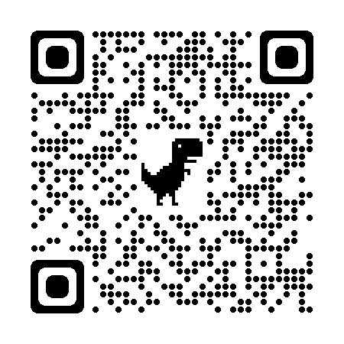

Current Threats and Solutions in Cyberneurosecurity
The rapid advancement of neurotechnologies raises concerns and risks related to cybersecurity, privacy, and ethical implications
The emerging field of cyberneurosecurity aims to address these issues by developing comprehensive frameworks and solutions
Exploring specific challenges and opportunities within legal and regulatory, ethical, technical, technological, medical, and cognitive domains
WWW.GULYAMOV.ORG

Slide 2

Legal and Regulatory Threats and Solutions
Potential human rights violations in areas of privacy, autonomy, and equality due to the collection, processing, and manipulation of neural data
Lack or inadequacy of legal and regulatory frameworks to address the unique risks and challenges posed by neurotechnologies
Need for specialized cyberneurosecurity laws and standards, as well as harmonization of national and international legal norms
WWW.GULYAMOV.ORG

Slide 3
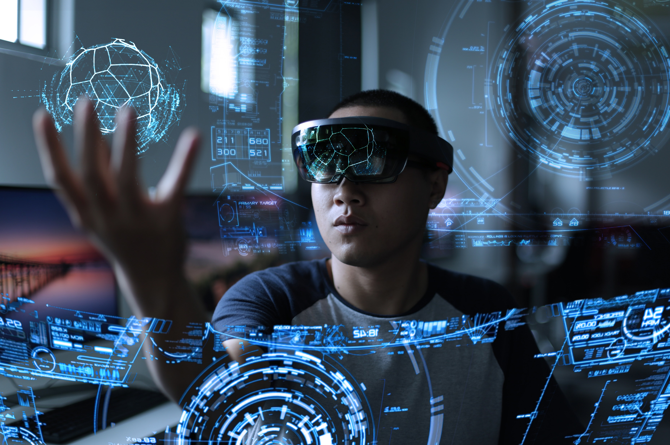
Ethical Threats and Solutions
Potential for unauthorized cyber influence on human cognitive functions and behavior, raising concerns about individual autonomy, mental privacy, and self-determination
Risk of discrimination and stigmatization based on tainted neural data used to make judgments or decisions that unfairly disadvantage certain individuals or groups
Development of cyber-ethical principles and codes of conduct to guide responsible research, development, and use of neurotechnologies, ensuring transparency, accountability, and responsibility
WWW.GULYAMOV.ORG

Slide 4

Hacking and Unauthorized Access to Neural Interfaces and Data as a Cyber Threat
Neurotechnologies become vulnerable to cyber attacks as they become increasingly connected and integrated with digital systems
Consequences can be severe, potentially compromising privacy, autonomy, and even physical and mental well-being of individuals using neurotechnologies
Crucial to develop robust cybersecurity measures tailored to the unique characteristics of neurotechnologies, such as secure authentication, encryption, anomaly detection, and fail-safe mechanisms
WWW.GULYAMOV.ORG

Slide 5

Implementing Advanced Encryption and Anonymization Methods for Neural Data in Cyberneurosecurity
The unique nature of neural data necessitates the use of particularly robust and reliable encryption and anonymization methods to protect privacy and security
Promising approaches include homomorphic encryption, differential privacy, federated learning, and secure multi-party computation
Regular auditing and updating of these methods is important to address evolving cyber threats and vulnerabilities, as well as maintaining user and public trust
WWW.GULYAMOV.ORG

Slide 6

Hardware and Software Vulnerabilities in Neurotechnology Devices as a Technological Threat to Cyberneurosecurity
Neurotechnology devices can be susceptible to hardware and software vulnerabilities that compromise their cybersecurity, privacy, and integrity
Hardware vulnerabilities can arise from design flaws, manufacturing defects, or insecure components, while software vulnerabilities can result from coding errors, configuration mistakes, or outdated libraries
Crucial to implement secure development practices, rigorous testing and verification procedures throughout the entire lifecycle of neurotechnology devices
WWW.GULYAMOV.ORG

Slide 7
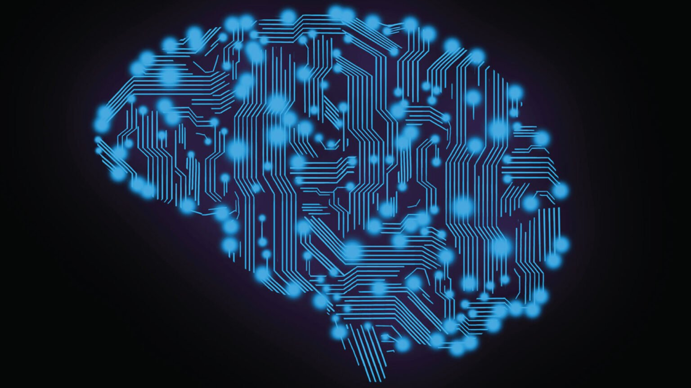
Developing Resilient and Fault-Tolerant Neurotechnology Systems for Cyberneurosecurity
Crucial to develop resilient and fault-tolerant neurotechnology systems that can maintain functionality and cybersecurity in the face of technical failures, disruptions, or cyber attacks
Key strategies include employing redundant and diverse components, implementing error detection and correction mechanisms, incorporating adaptive and self-healing architectures, and establishing robust testing and validation procedures
Important to consider the ethical and societal implications, such as potential impact on user autonomy, privacy, and trust, and engage in ongoing dialogue with stakeholders
WWW.GULYAMOV.ORG

Slide 8

Applying Computational Law and Legal Informatics to Address Cyber Threats in Neurotechnologies as a Cyberneurosecurity Tool (Threats and Solutions)
Computational law and legal informatics offer powerful analytical tools and methods to assist in the development, implementation, and enforcement of cyberneurosecurity laws, policies, and regulations
Key challenges include uncertainty and ambiguity in existing laws, complexity and dynamism of the neurotechnology landscape, and the need for balanced and evidence-based approaches
Potential solutions involve developing formal logical models, applying natural language processing and machine learning techniques, utilizing computer modeling and simulations, and facilitating collaboration between legal and technical experts
WWW.GULYAMOV.ORG

Slide 9
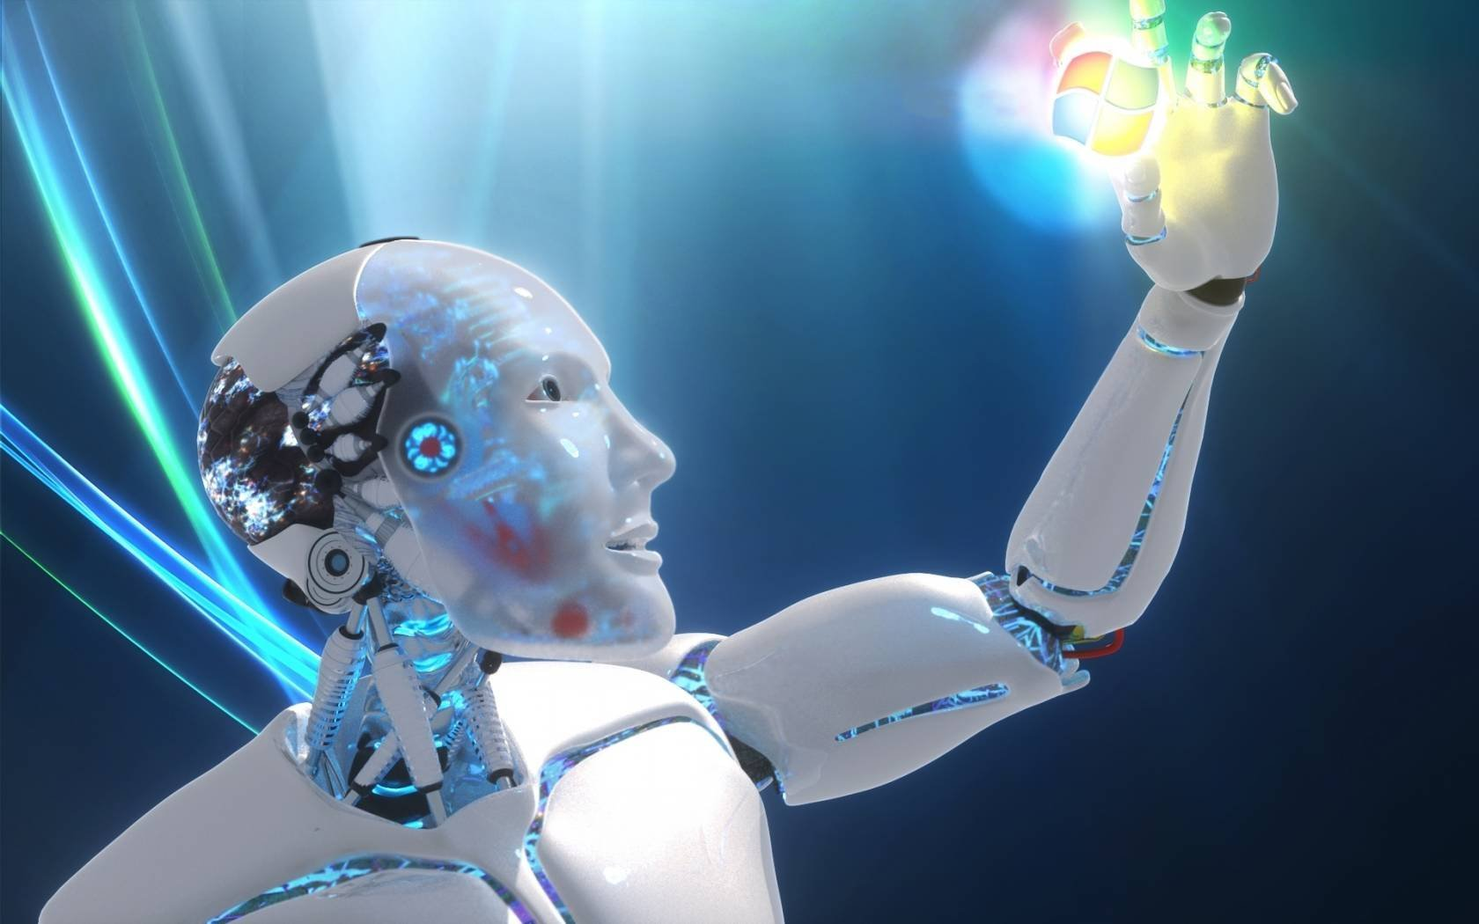
Quantum Technologies as a Promising Approach to Addressing Cyberneurosecurity Challenges and Mitigating Cyber Threats in Neurotechnologies (Threats and Solutions)
Quantum technologies offer unprecedented opportunities for enhancing cyberneurosecurity and addressing cutting-edge cyber threats in the realm of neurotechnologies
Key challenges include the potential of quantum computers to break traditional cryptography, technical difficulties and costs of implementation, the need for new quantum security protocols and standards, and verification and validation issues
Promising solutions involve employing quantum cryptography, investigating quantum-resistant algorithms, developing quantum error detection and correction methods, and establishing quantum networks and communication architectures
WWW.GULYAMOV.ORG

Slide 10
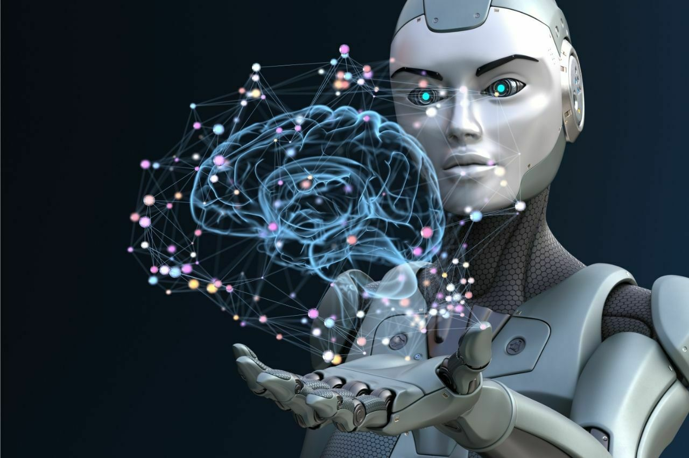
Potential Misuse of Neurotechnologies for Cognitive Enhancement and Associated Cyber Risks
Potential misuse of neurotechnologies for cognitive enhancement, especially in non-clinical or unauthorized settings, introduces serious cyber risks
Potential cyber risks include unequal access and proliferation leading to exacerbation of inequalities, coercion or pressure to use resulting in erosion of personal autonomy, adverse health consequences or unintended cyber effects, and societal shifts devaluing natural cognition
Essential to develop clear policies and regulations governing the use of neurotechnologies for cognitive enhancement, based on a balanced consideration of potential benefits and cyber risks, and ongoing public dialogue
WWW.GULYAMOV.ORG

Slide 11
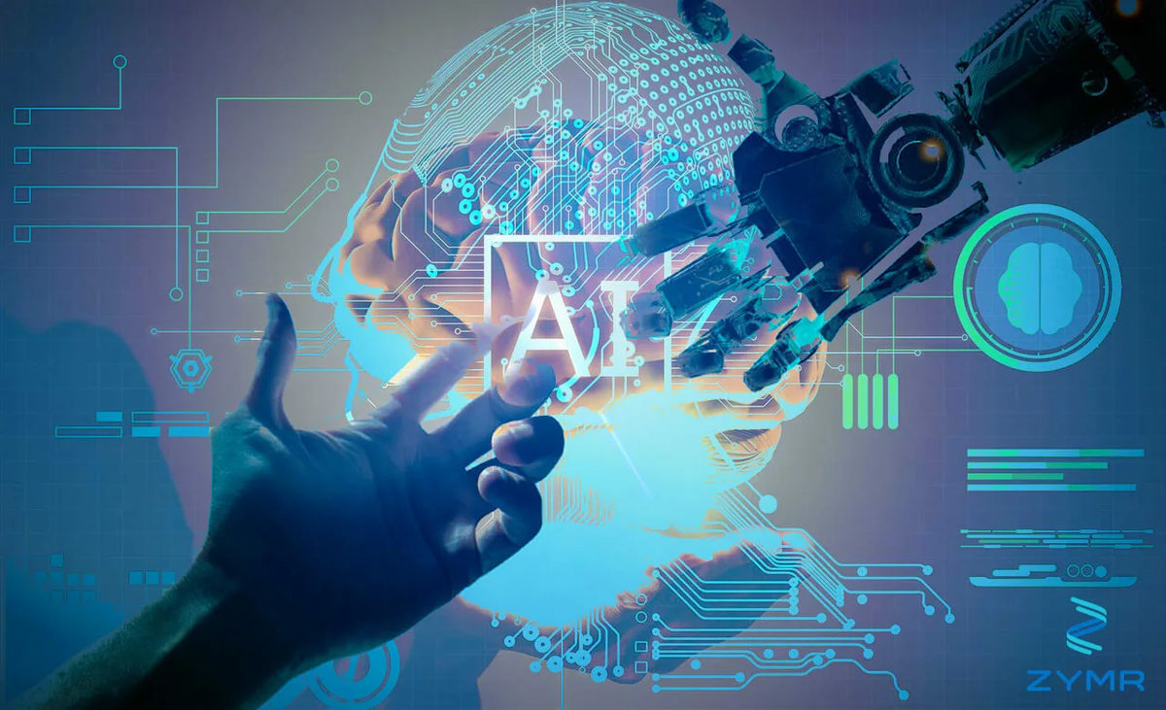
Conclusion
Cyberneurosecurity presents a complex landscape of cyber threats and challenges requiring a multifaceted and proactive approach
Key cyber threats and potential solutions explored across legal and regulatory, ethical, technical, technological, medical, and cognitive domains
Addressing cyberneurosecurity challenges will require collaborative and interdisciplinary efforts from diverse fields
Fostering open dialogue, mutual learning, and coordinated action to realize the transformative potential of neurotechnologies while prioritizing cybersecurity, health, well-being, and the rights of individuals and society
WWW.GULYAMOV.ORG

Slide 12

THANK YOU FOR THE ATTENTION!
WWW.GULYAMOV.ORG

