Slide 1

Legal Protection of Databases
GULYAMOV SAID SAIDAKHRAROVICH
Doctor of Law Science, Professor,
Head of the Department of Cyber Law
of the Tashkent State University of Law

Slide 2



INTRODUCTION
The volume of the global database market in 2020 exceeded 80 billion euros and is expected to double by 2025.
Europe accounts for more than 30% of the world market, highlighting the strategic importance of this sector for the EU economy.
It is necessary to critically analyze the current system of legal protection of databases in the EU and outline potential directions for reforming European legislation.
WWW.GULYAMOV.ORG

Slide 3

Dichotomy of protection: copyright and sui generis right
Original databases that are the result of the author's creative activity are protected by copyright.
Directive 96/9/EC introduces a special sui generis right for non-original databases, the creation of which required substantial investment.
The European model of database protection has a two-tier character: original databases are protected by copyright, while non-original ones are protected by the sui generis right.
WWW.GULYAMOV.ORG

Slide 4

Fundamental principles of legal protection
The principle of originality for copyright protection.
The doctrine of substantial investment as a key principle for granting protection by the sui generis right.
Limited term of protection: 70 years after the author's death for copyright and 15 years from the completion of the database for the sui generis right.
WWW.GULYAMOV.ORG

Slide 5

Directive 96/9/EC of the European Parliament and of the Council of 11 March 1996 on the legal protection of databases
Directive 96/9/EC introduces a comprehensive regime for the protection of databases, including both traditional copyright protection for original databases and a new sui generis right for non-original databases.
The Directive enshrines a number of key principles and provisions, including the criterion of originality, the doctrine of substantial investment, limited term of protection, exceptions and limitations to database rights.
The adoption of Directive 96/9/EC was an important milestone in the development of European intellectual property law and laid the foundation for the formation of a modern system of legal protection of databases in the EU.
WWW.GULYAMOV.ORG

Slide 6

Directive 2001/29/EC of the European Parliament and of the Council of 22 May 2001
Directive 2001/29/EC introduces a number of important provisions concerning exceptions to copyright in the digital environment.
Article 5 of Directive 2001/29/EC provides for optional exceptions to copyright for a number of cases of free use of works, including databases.
Directive 2001/29/EC makes an important contribution to adapting European copyright law to the realities of the digital age and establishes a number of fundamental provisions that are important for the functioning of databases in the online environment.
WWW.GULYAMOV.ORG

Slide 7

Directive 2019/790 of the European Parliament
Directive 2019/790 introduces mandatory exceptions to copyright and the sui generis right to extract information from a database for the purposes of text and data mining (TDM).
Directive 2019/790 opens up new opportunities for the digitization and provision of online access to collections of libraries, museums, and archives, including databases that are no longer available on the market.
Although Directive 2019/790 does not make fundamental changes to the legal regime for the protection of databases, it contains a number of important provisions aimed at ensuring a balance between the protection of intellectual property rights and the promotion of innovation, scientific research, and access to knowledge in the digital age.
WWW.GULYAMOV.ORG

Slide 8

Regulation 2016/679 of the European Parliament
The General Data Protection Regulation (GDPR) establishes uniform rules for the processing of personal data in the EU and is of key importance for the functioning of databases containing information about natural persons.
The key principle of the GDPR is the lawfulness of personal data processing, which is legal only if at least one of the six grounds specified in Art. 6 is met.
The GDPR sets strict requirements for the cross-border transfer of personal data outside the EU, allowing it only under certain conditions and safeguards.
WWW.GULYAMOV.ORG

Slide 9

Directive 2016/1148 of the European Parliament and of the Council of 6 July 2016
The Network and Information Security (NIS) Directive establishes common security requirements for network and information systems for operators of essential services and digital service providers.
The provisions of the NIS Directive concerning the security of network and information systems of operators of essential services are of particular importance for databases.
Operators of essential services that use databases in their activities must implement appropriate mechanisms to protect the integrity, availability, and confidentiality of such databases in accordance with the requirements of the NIS Directive.
WWW.GULYAMOV.ORG

Slide 10
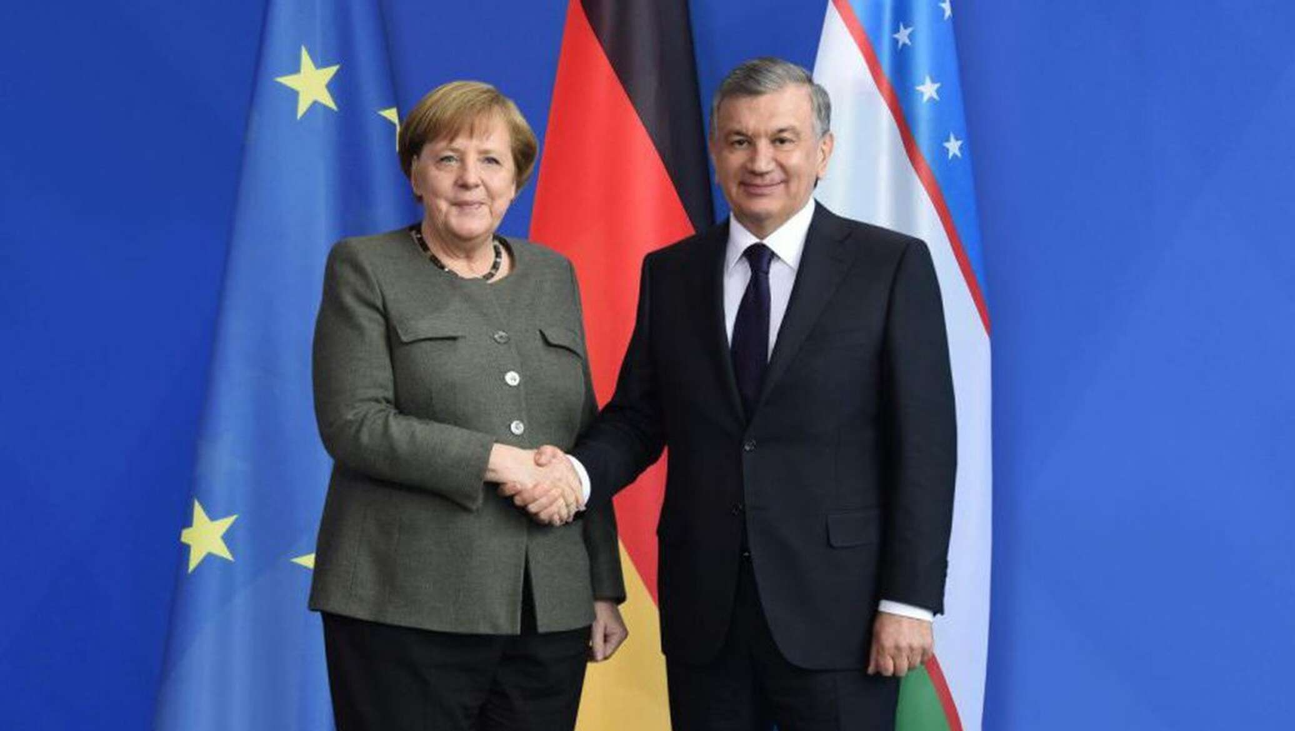
THANK YOU FOR THE ATTENTION!
WWW.GULYAMOV.ORG

