Slide 1

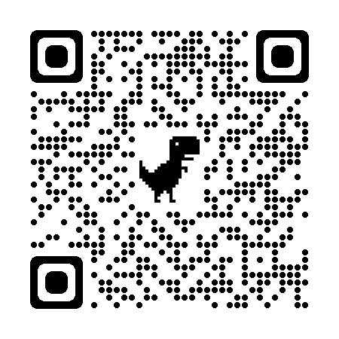

Predictive Policing Models and Risk Assessment
Predictive policing models forecast the likelihood of future crime based on historical data and risk factors
These models can perpetuate biases and inequalities in the criminal justice system
Effective crime prevention requires addressing underlying social and structural issues
WWW.GULYAMOV.ORG

Slide 2

Crime Hotspot Identification and Resource Allocation
AI can identify crime hotspots by analyzing crime data and environmental factors
Predictive policing algorithms can guide the deployment of police resources to high-risk areas
The use of AI for crime hotspot identification raises concerns about bias, privacy, and civil liberties
WWW.GULYAMOV.ORG

Slide 3

Automated Processing of Digital Forensic Evidence
AI can help process large volumes of digital evidence, such as computer hard drives and mobile phones
Methods like hash set filtration and named entity recognition can streamline the analysis process
The use of AI for digital forensics must comply with data protection rules and ensure the protection of individual rights
WWW.GULYAMOV.ORG

Slide 4

Enhancing Video and Image Analysis with AI
AI techniques like super-resolution, video summarization, and object detection can improve the quality and efficiency of video and image analysis
These methods can help investigators extract valuable information from low-quality or voluminous visual data
The admissibility and reliability of AI-generated video and image evidence remain subject to legal and ethical scrutiny
WWW.GULYAMOV.ORG

Slide 5

Facial Recognition in Surveillance Footage and Databases
Facial recognition can help identify suspects by matching them against databases of known individuals
The widespread use of facial recognition raises concerns about privacy, civil liberties, and the potential for bias and abuse
International guidelines and regulations aim to ensure the responsible use of facial recognition in law enforcement
WWW.GULYAMOV.ORG

Slide 6

Behavioral Analysis and Psychological Profiling
AI can automate and scale behavioral analysis and psychological profiling in criminal investigations
These methods can help identify signs of radicalization, assess personality traits, and forecast criminal behavior
The use of AI for profiling raises legal, ethical, and scientific concerns about privacy, fairness, and validity
WWW.GULYAMOV.ORG

Slide 7

Case Management Systems with AI Recommendations
AI-powered case management systems can extract relevant information and provide insights to investigators and prosecutors
These systems can forecast case outcomes, optimize resource allocation, and analyze evidence
The use of AI in case management raises challenges related to due process, bias, and operational requirements
WWW.GULYAMOV.ORG

Slide 8

Sentencing and Parole Decision Support Tools
AI-based tools can assist judges and parole boards in making decisions about offender punishments and release conditions
These tools assess recidivism risk based on factors like criminal history and social circumstances
The use of AI in sentencing and parole decisions has been criticized for perpetuating bias and lacking transparency and accountability
WWW.GULYAMOV.ORG

Slide 9

THANK YOU FOR THE ATTENTION!
WWW.GULYAMOV.ORG

